Slide 1
Solving programming problems
by Hans Wichman

Slide 2
Introduction
These slides contain an overview with examples of different approaches to solve programming problems, some very practical, some bordering on the philosophical (feel free to skip those)
Note that not all of these approaches apply to every problem
Note that some of the items refer to specific lectures and will be explained in more detail during that specific lecture

Slide 3
(Algorithmic) problem solving approaches
Divide & Conquer
Acting out the algorithm
Iterations and minimum viable products
Experiment freely
Walk it off
Spam that console
Binary exclusion
Hypothesize
Watch that rerun
Using the debugger
Inspect the callstack
Visualize your program state
Trace tables
Unit Testing
Pseudocode & Drawings

Slide 4
Divide & Conquer

Slide 5
Divide and conquer
Problems are either trivial or non trivial:
Trivial: they can be converted to code with little trouble
Non-trivial: they need to be split into sub problems in order to become trivial
Keep asking yourself:
Is this problem trivial or non trivial?
How can I split this problem into smaller problems?
As an example see the dungeon breakdown in the slides for lecture 1
The next principles also provide handholds/questions you can ask yourself, while you are trying to make problems 'smaller'

Slide 6
Acting out the algorithm

Slide 7
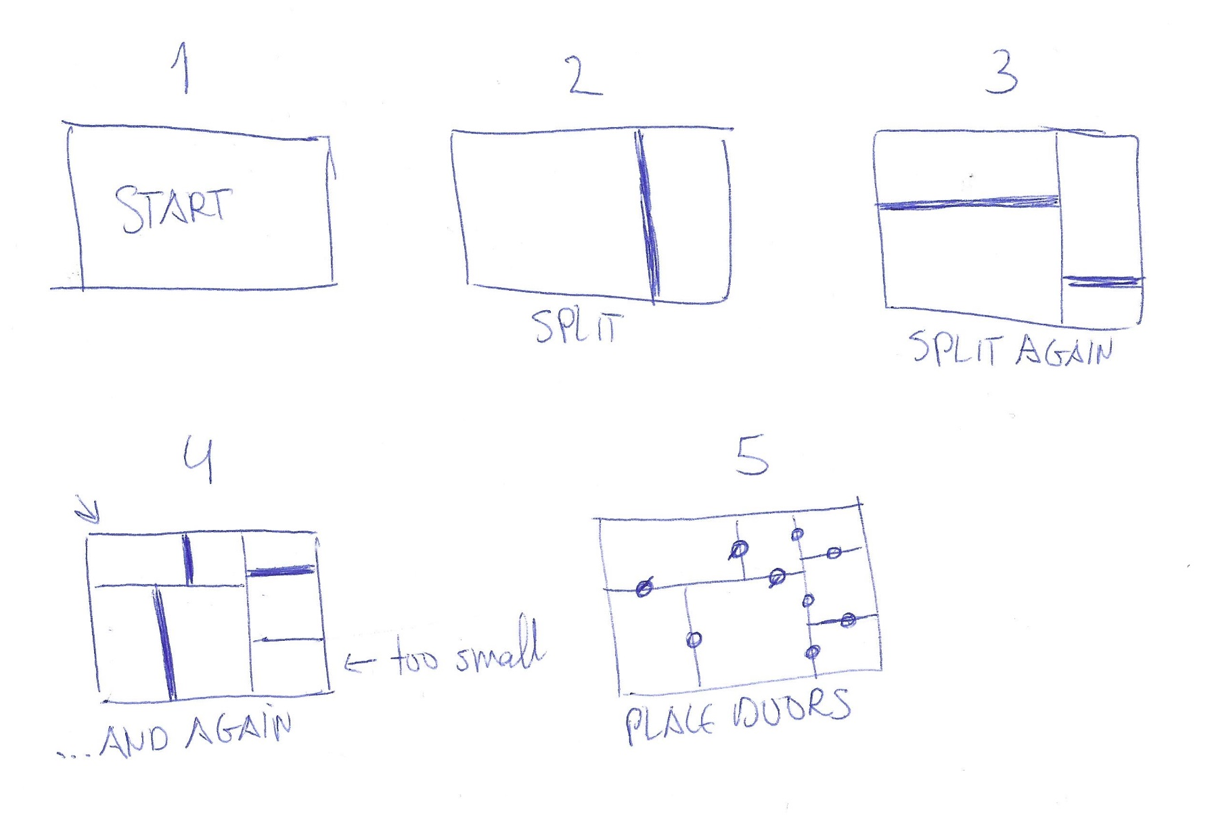
Acting out the algorithm
If you cannot write down/visualize the algorithm step by step on paper, chances are you cannot implement it
Step 1 – Step away from the computer
Step 2 – Act out the algorithm on paper, re-tracing the steps
Step 3 – Prototype on the computer
Step 4 – Start over at step 1 if necessary
For example, for the dungeon assignment

Slide 8
Iteration / MVP

Slide 9
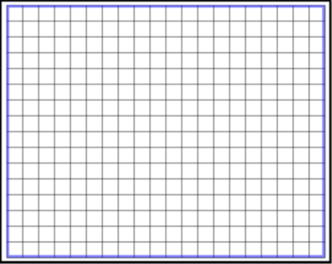
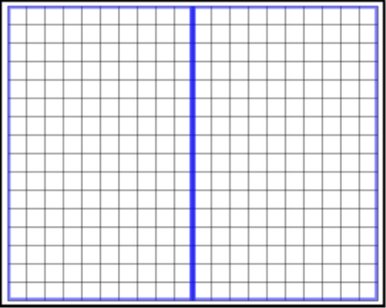
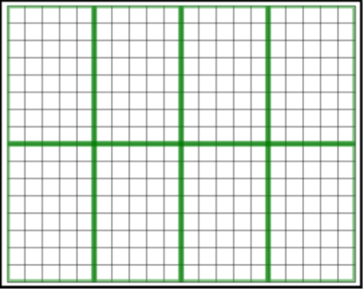
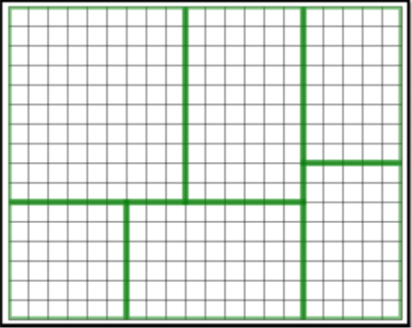
Iteration
Algorithm execution involves a lot of iteration (eg for loops)
But algorithm development ALSO involves a lot of iteration
Instead of Divide & Conquer, we could say Iterate & Conquer ☺
For example, referring to the dungeon problem from assignment 1 again:
First, simple iteration:
Create 1 room
Second, little bit harder:
Split 1 room
Third, a little bit harder:
Split all rooms
Endboss:
Split all rooms randomly

Slide 10
Minimum viable product
Iteration is closely tied to the concept of Minimum Viable Product
What is the minimal step I can take, that takes me in the direction of a solution?
What is the next minimal step I can take, that takes me a bit further?
Answering questions likes these often drive the iterations of your code (see previous slide)
At first this may feel like going ultra slow, but speed & stepsize will increase over time

Slide 11
Experiment freely

Slide 12
Experimentation
Given the input and output requirements of a problem, it is important to play around
For example, given the dungeon size and minimum room size, can you:
generate 1 room with the size of the dungeon?
explain how the room coordinates work?
generate random rooms?
subdivide a single room into two rooms?
print whether a room meets the minimum size requirement?
print whether any rooms have an overlap?
Constantly think: what else can I try that I haven't tried yet no matter how small
The mindset of experimentation helps avoiding analysis paralysis
Notes:
"Coming up with algorithms isn’t always easy. In addition, more than one algorithm may solve a given
problem. Some solutions will be simple, others will be complex, and some will be more efficient than
others. The simplest solution isn’t always the most obvious either. While rigorous, scientific analysis is
always a good starting point, you can often find yourself stuck in analysis paralysis. Sometimes a bit of
good old-fashioned creativity is needed. Try different approaches, and investigate hunches. Determine
why your current attempts at a solution work for some cases and not for others. There is a reason why
one of the seminal works on so-called computer science and software engineering is called The Art of
Computer Programming (authored by Donald E. Knuth)." – From Beginning Algorithms

Slide 13
Embrace failure

Slide 14
Embrace failure
This ties in with experimenting freely:
Trying to do things right the first time will not help you
Trying & failing is part of the game
By trying, you find out what works and what doesn't, even if it is just for example randomly changing numbers to see the effect
Silence your inner voice (unless it's making compliments, but it hardly ever does)

Slide 15
Walk it off

Slide 16
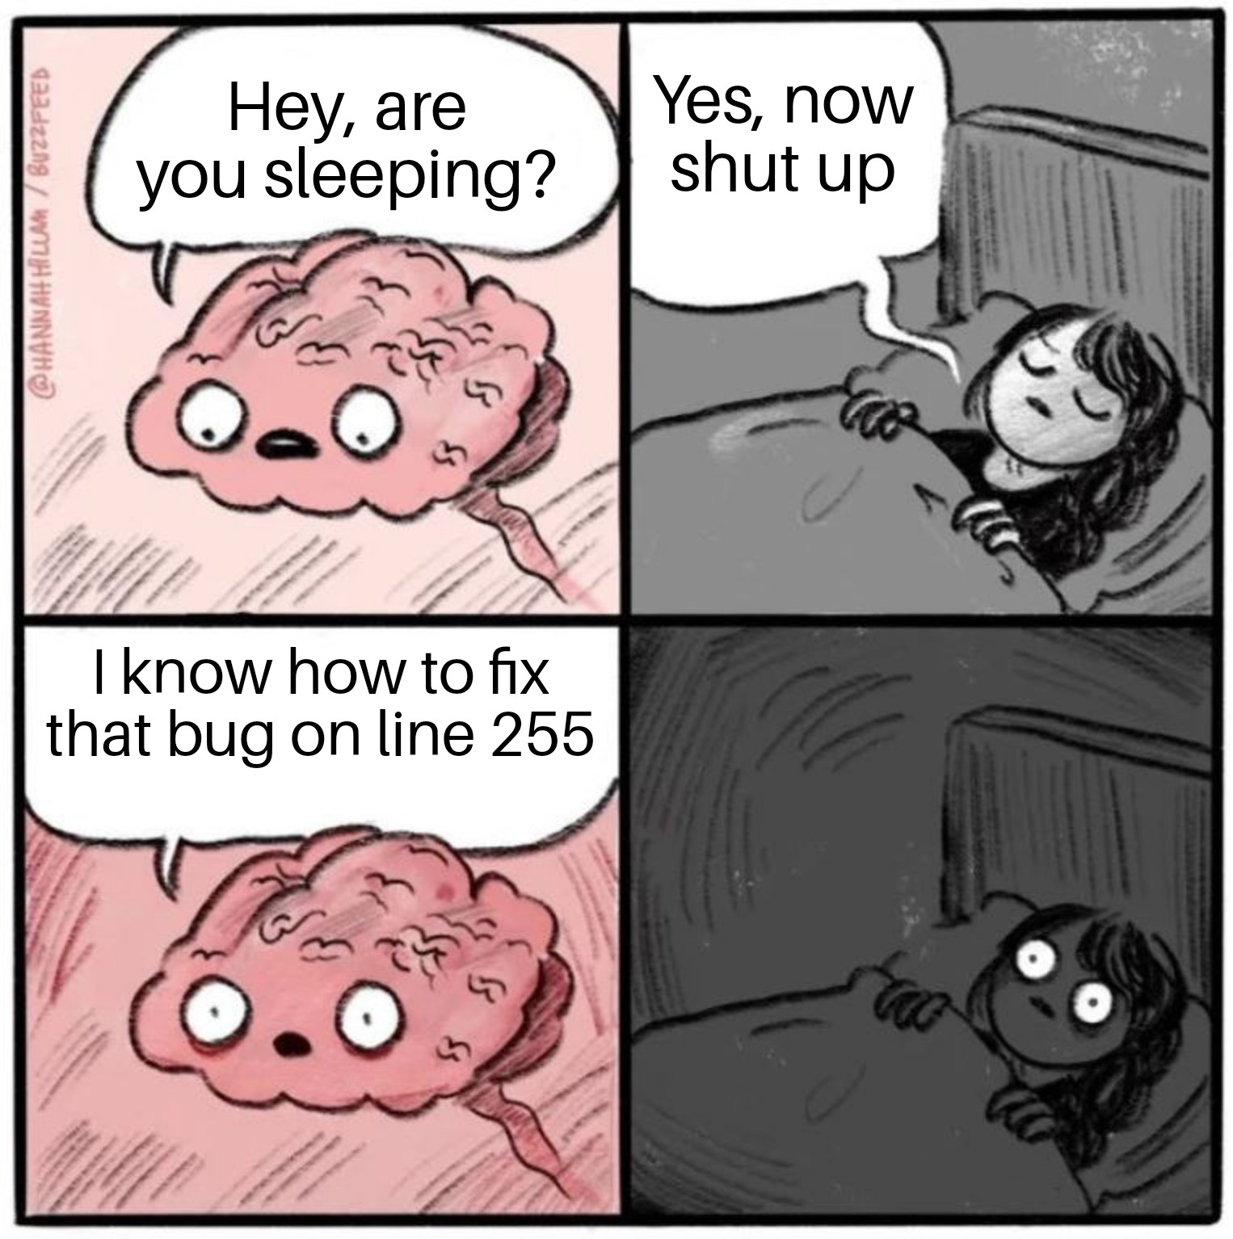
Walk it off
Problems are sometimes best solved walking or sleeping instead of coding:
Take a walk
Work on something else
Get some sleep
Discuss the problem with a friend
Explain the problem to your mom/dog/goldfish or buy a rubber duck, name it, and explain it to the duck
Skip that specific part and work on the next assignment

Slide 17
Spam that Console

Slide 18
Console.WriteLine is your 'friend'
When stuck you need to gain control/insight/a grip on your code
One way to do that is through a lot of 'good' debug statements
What does 'good' mean?
Objects should have descriptive correctly implemented ToString methods
The debug output should describe the program flow, showing for example:
Input data → Algorithm progress → Output data
Keep improving and changing the debug output, using whitespace, newlines, tabs and indents until you can easily follow the program flow

Slide 19
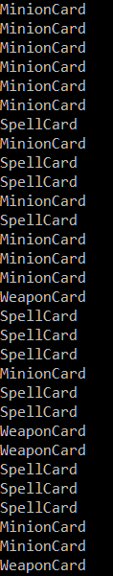
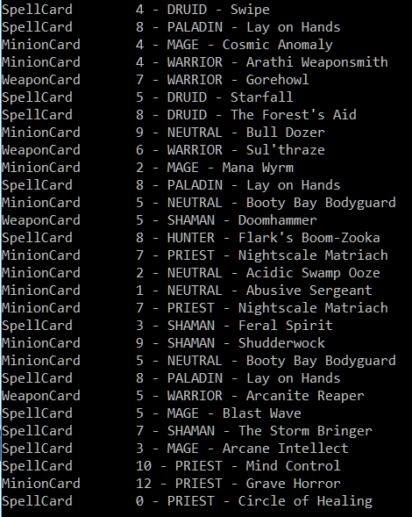
Example of a bad vs a good ToString method
Bad vs Good

Slide 20
Advanced logging options
Conditionals (see hearthstone example in lecture 2)
Using logging frameworks

Slide 21
Binary exclusion

Slide 22
Binary exclusion
The binary exclusion/elimination principle looks a lot like the 'guess-a-number' game, where you can only answer higher or lower
When programming, the principle is this:
If your code breaks, or you are stuck on a problem, comment out roughly 50% of your code
If the problem disappears, it was in the 'disabled' code
If the problem is still there, it is in the code that is still 'enabled'
Keep repeating this process until you've narrowed down the problem (And then start debugging that piece of code → see next slides)
Of course in a OO program this is not always that easy to do

Slide 23
Hypothesize

Slide 24
Hypothesize
Brainstorm about what the problem could be
Sort the answers based on likelihood
Think about tests you can execute to validate each hypothesis
Word of warning:
In my own experience, on multiple occasions in the past, the least likely 'cause' turned out to be the culprit ☺. In other words, alternatively, you could also ask yourself: what will definitely not be the problem and try that first.

Slide 25
Watching reruns

Slide 26
Watching reruns
Your program breaks so you run it again to see if the problem magically disappeared. It didn't. You'll try again and the problem will still be there. It's okay, we all do that ☺
Although running and re-running doesn't fix your problem, it does allow you to try and test as many different things as possible. Change a number here and there, a +1 into a -1, a > into a >= or < and see what happens.
Just make sure that after fixing the problem, you understand the why and how. That is the difference between Programming by Coincidence, and actually knowing what you are doing.

Slide 27
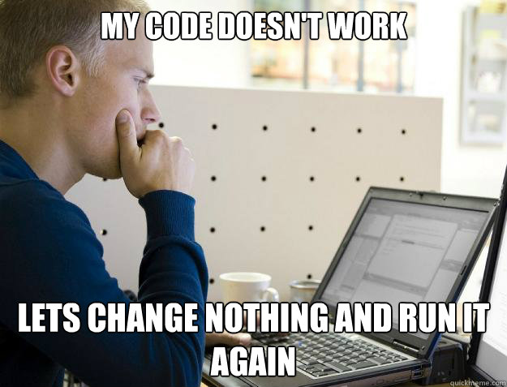
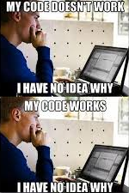
Watching reruns
And yes, there are memes about this, in case you were wondering ☺

Slide 28
Using the debugger

Slide 29
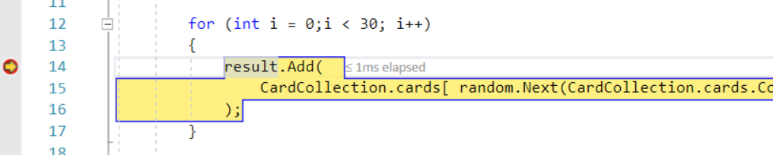
Using the debugger
Your IDE's debugger allows you to set multiple so called breakpoints, usually by clicking on or next to the line numbers (differs per IDE):
A breakpoint is indicated with a red dot

Slide 30
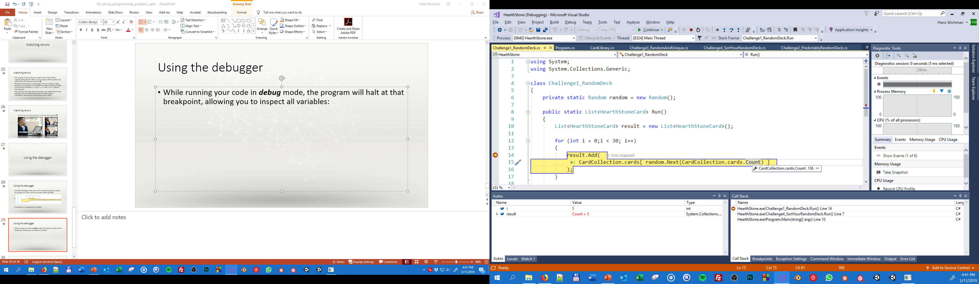
Using the debugger
While running your code in debug mode, the program will halt at that breakpoint, allowing you to inspect all variables:
Note the value of i and result, the value of cards.Count under the mouse and the call stack on the right. You can click/expand all of these.

Slide 31
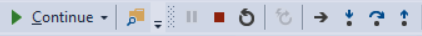
Using the debugging toolbar 1/2
While in debug mode, you can use the debug toolbar to control the debug process:
Start running the code again until the next breakpoint
Stop the program
Restart the program
Move to the next line

Slide 32
Using the debugging toolbar 2/2
For deeper inspection you can also 'follow' the program flow through methods call using 'Step into' and 'Step out':
Instead of just executing the next line as a single monolithic whole, the debugger will jump into the current method call (if applicable) to continue debugging there.
To exit the current level of detail, you can press this button and continue at the parent. Try these options with your own nested methods for better understanding.

Slide 33
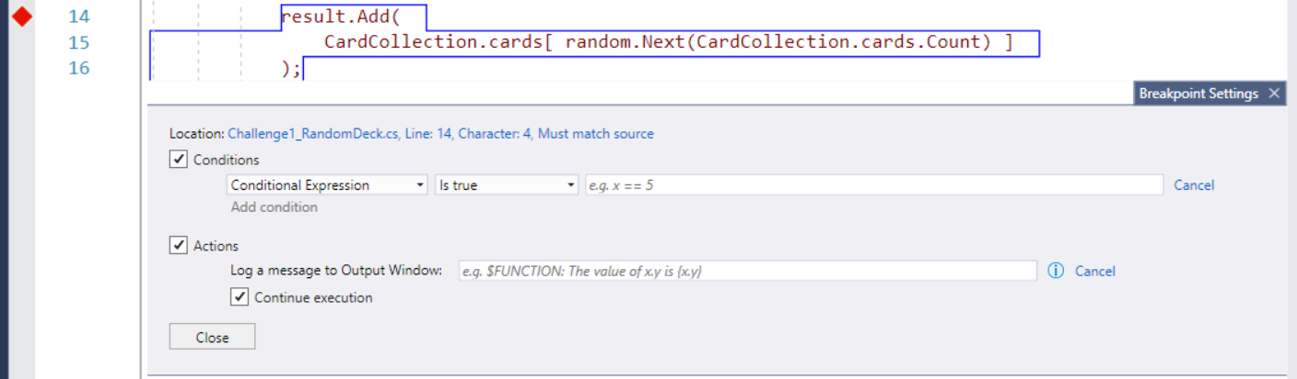
Using the debugger
MORE INFO
For more control you can:
enable/disable breakpoints while your code is running
specify specific conditions and actions for your breakpoint (and combine this with logging!)

Slide 34
Inspect the Call Stack

Slide 35
Inspect the Call Stack
MORE INFO
Every method call is put onto the Call Stack (if you don't know what this means → check out the C# Essential Slides on BlackBoard)
The moment your program crashes or hits a breakpoint, you can inspect this call stack and double click calls to inspect the program flow:

Slide 36
Visualize your program state

Slide 37
Visualize your program state
Debugging is great, printing debug info as well, but sometimes you need to visualize things (maybe even step by step) to actually get a grip on what is happening, for example during a step by step pathfinding algorithm (more about this in lecture 4):

Slide 38
Visualize your program state
There are two basic ways to do that for the assignments:
Do not execute the algorithm in one go, but trigger a next step on keypress For example instead of calling 'Generate' you would implement: Reset() & Step(), where Reset() initializes the algorithm and Step() executes one step of your algorithm when you press a key and redraws. An example of this will be shown during one of the lectures.
A dirty trick to do the same will less hassle is using Threads, as in: new Thread (myAlgorithm.Generate).Start(); and use Thread.Sleep(1000); redraw(); in your algorithm loop. Note that the program might crash now and then, and you should never do this in production code, but for quick and dirty debugging it's fine. More info in threading will be provided during the networking course.

Slide 39
Trace tables

Slide 40
Trace tables
Trace tables keep track of all important algorithmic variables through the iterations of the algorithm line by line
Depending on the specific algorithm this might be very easy to do, or next to impossible.
In general it is very worthwhile to:
try to predict the output of the algorithm based on well chosen input (well chosen is 'leading to output that you can verify to be correct by hand')
execute the algorithm
compare the algorithm values/output with your predicted values

Slide 41
Trace table example
MORE INFO
int result = 0;
for (int i = 0; i < 4; i++) {
if (result % 2 == 0) result = result + i*4 + 1;
else result = result * 2;
}
Start* | - | result = 0
Iteration 1 | i = 0 | result = 1
Iteration 2 | i = 1 | result = 2
Iteration 3 | i = 2 | result = 11
Iteration 4 | i = 3 | result = 22
* Note that we could also do before and after values or a line by line approach as can be found under the 'more info' button

Slide 42
Unit testing

Slide 43
Unit testing
MORE INFO
This is a large topic, which we'll get into more in the second year. You had a taste of it during Physics Programming and the idea with unit testing is that you test the smallest units of your code to verify they are correct. What you haven't seen yet is that there are actually unit testing frameworks to help you do that and make this easier on you, but the principle remains the same:
Verify that the foundations on which you are building your code are indeed functioning correctly. Through assert statements, through unit testing frameworks, through Console.WriteLine (myValue == expectedValue) etc.

Slide 44
Pseudocode and drawings

Slide 45
Pseudocode and drawings
Pseudo code and drawings (sketches, flowcharts, doodles, etc) can help you describe and gain more clarity on your algorithm. For more information please refer to the "Describing algorithms" slides on blackboard.

